Slide 1
CHAPTER 19
GENETIC ALGORITHM MATLAB TOOLBOX
“Principles of Soft Computing, 2nd Edition”
by S.N. Sivanandam & SN Deepa
Copyright © 2011 Wiley India Pvt. Ltd. All rights reserved.

Slide 2
The genetic algorithm is a method for solving both constrained and unconstrained optimization problems that is based on natural selection, the process that drives biological evolution.
The genetic algorithm repeatedly modifies a population of individual solutions. At each step, the genetic algorithm selects individuals at random from the current population to be parents and uses them produce the children for the next generation.
Over successive generations, the population "evolves" toward an optimal solution.
“Principles of Soft Computing, 2nd Edition”
by S.N. Sivanandam & SN Deepa
Copyright © 2011 Wiley India Pvt. Ltd. All rights reserved.

Slide 3
The Genetic Algorithm and Direct Search Toolbox is a collection of functions that extend the capabilities of the Optimization Toolbox and the MATLAB numeric computing environment. The Genetic Algorithm and Direct Search Toolbox includes routines for solving optimization problems using
      GENETIC ALGORITHM
      DIRECT SEARCH
These algorithms enable you to solve a variety of optimization problems that lie outside the scope of the Optimization Toolbox.
“Principles of Soft Computing, 2nd Edition”
by S.N. Sivanandam & SN Deepa
Copyright © 2011 Wiley India Pvt. Ltd. All rights reserved.

Slide 4
The genetic algorithm uses three main types of rules at each step to create the next generation from the current population:
Selection rules select the individuals, called parents, that contribute to the population at the next generation.
Crossover rules combine two parents to form children for the next generation.
Mutation rules apply random changes to individual parents to form children.
“Principles of Soft Computing, 2nd Edition”
by S.N. Sivanandam & SN Deepa
Copyright © 2011 Wiley India Pvt. Ltd. All rights reserved.

Slide 5
The genetic algorithm at the command line, call the genetic algorithm function ga with the syntax
[x fval] = ga(@fitnessfun, nvars, options) where
@fitnessfun is a handle to the fitness function.
nvars is the number of independent variables for the fitness function.
options is a structure containing options for the genetic algorithm. If you do not pass in this argument, ga uses its default options.
The results are given by
x — Point at which the final value is attained.
fval — Final value of the fitness function.
“Principles of Soft Computing, 2nd Edition”
by S.N. Sivanandam & SN Deepa
Copyright © 2011 Wiley India Pvt. Ltd. All rights reserved.

Slide 6
COMMAND LINE FUNCTIONS
Bin2int - BINary string to INTeger string conversion
bin2real - BINary string to REAL vector conversion
bindecod - BINary DECODing to binary, integer or real numbers
compdiv - COMPute DIVerse things of GEA Toolbox
compdiv2 - COMPute DIVerse things of GEA Toolbox
compete - COMPETition between subpopulations
comploc - COMPute LOCal model things of toolbox
compplot - COMPute PLOT things of GEA Toolbox
geamain2 - MAIN function for Genetic and Evolutionary Algorithm toolbox for matlab
initbp - CReaTe an initial Binary Population
initip - CReaTe an initial (Integer value) Population
mutate - high level MUTATion function
mutbin - MUTation for BINary representation
“Principles of Soft Computing, 2nd Edition”
by S.N. Sivanandam & SN Deepa
Copyright © 2011 Wiley India Pvt. Ltd. All rights reserved.

Slide 7
mutbmd - real value Mutation like Discrete Breeder genetic algorithm
mutcomb - MUTation for combinatorial problems
mutes1 - MUTation by Evolutionary Strategies 1, derandomized Self Adaption
mutexch - MUTation by eXCHange
mutint - MUTation for INTeger representation
mutinvert - MUTation by INVERTing variables
mutmove - MUTation by MOVEing variables
mutrand - MUTation RANDom
mutrandbin - MUTation RANDom of binary variables
Mutrandbin - MUTation RANDom of binary variables
mutrandint - MUTation RANDom of integer variables
mutrandperm - MUTation RANDom of binary variables
Mutrandreal - MUTation RANDom of real variables
“Principles of Soft Computing, 2nd Edition”
by S.N. Sivanandam & SN Deepa
Copyright © 2011 Wiley India Pvt. Ltd. All rights reserved.

Slide 8
Rankgoal - perform goal preference calculation between
multiple objective values
ranking - RANK-based fitness assignment, single and
multi objective, linear and nonlinear
rankplt - RANK two multi objective values Partially Less Than
rankshare - SHARing between individuals
recdis - RECombination DIScrete
recdp - RECombination Double Point
recdprs - RECombination Double Point with Reduced
Surrogate
recgp - RECombination Generalized Position
recint - RECombination extended INTermediate
reclin - RECombination extended LINe
reclinex - EXtended LINe RECombination
recmp - RECombination Multi-Point, low level
“Principles of Soft Computing, 2nd Edition”
by S.N. Sivanandam & SN Deepa
Copyright © 2011 Wiley India Pvt. Ltd. All rights reserved.

Slide 9
function recombin - high level RECOMBINation function
recpm - RECombination Partial Matching
recsh - RECombination SHuffle
recsp - RECombination Single Point
“Principles of Soft Computing, 2nd Edition”
by S.N. Sivanandam & SN Deepa
Copyright © 2011 Wiley India Pvt. Ltd. All rights reserved.

Slide 10
SELECTION FUNCTIONS
selection - high level SELECTion function
sellocal - SELection in a LOCAL neighbourhood
selrws - SELection by Roulette Wheel Selection
selsus - SELection by Stochastic Universal Sampling
seltour - SELection by TOURnament
seltrunc - SELection by TRUNCation
“Principles of Soft Computing, 2nd Edition”
by S.N. Sivanandam & SN Deepa
Copyright © 2011 Wiley India Pvt. Ltd. All rights reserved.

Slide 11
OBJECTIVE FUNCTIONS
initdopi - INITialzation function for DOuble Integrator objdopi
initfun1 - INITialzation function for de jong's FUNction 1
mopfonseca1 - MultiObjective Problem: FONSECA's function 1
mopfonseca2 - MultiObjective Problem: FONSECA's function 1
moptest - MultiObjective function TESTing
obj4wings - OBJective function FOUR-WINGS.
objbran - OBJective function for BRANin rcos function
objdopi - OBJective function for DOuble Integrator
objeaso - OBJective function for EASom function
objfletwell - OBJective function after FLETcher and PoWELL
“Principles of Soft Computing, 2nd Edition”
by S.N. Sivanandam & SN Deepa
Copyright © 2011 Wiley India Pvt. Ltd. All rights reserved.

Slide 12
GA GRAPHICAL USER INTERFACE
The Genetic Algorithm Tool is a graphical user interface that enables you to use the genetic algorithm without working at the command line. To open the Genetic Algorithm Tool, enter
Gatool
at the MATLAB command prompt.
“Principles of Soft Computing, 2nd Edition”
by S.N. Sivanandam & SN Deepa
Copyright © 2011 Wiley India Pvt. Ltd. All rights reserved.

Slide 13
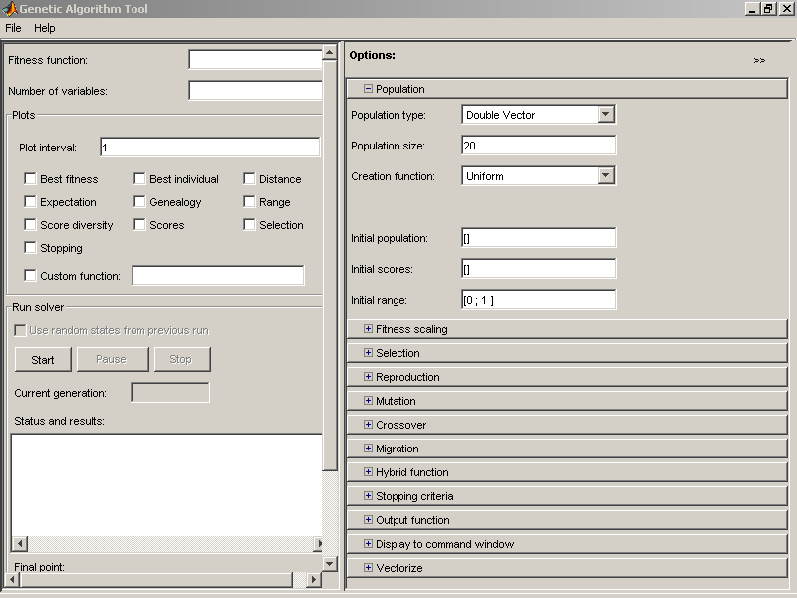
“Principles of Soft Computing, 2nd Edition”
by S.N. Sivanandam & SN Deepa
Copyright © 2011 Wiley India Pvt. Ltd. All rights reserved.

Slide 14
To use the Genetic Algorithm Tool, you must first enter the following information:
Fitness function — The objective function you want to minimize. Enter the fitness function in the form @fitnessfun, where fitnessfun.m is an M-file that computes the fitness function.
Number of Variables – The number of variables in the given fitness function should be given.
“Principles of Soft Computing, 2nd Edition”
by S.N. Sivanandam & SN Deepa
Copyright © 2011 Wiley India Pvt. Ltd. All rights reserved.

Slide 15
PLOT OPTIONS
1. Best fitness
Best individual
Distance
Expectation
Genealogy
Range
Score Diversity
Scores
Selection
Stopping
“Principles of Soft Computing, 2nd Edition”
by S.N. Sivanandam & SN Deepa
Copyright © 2011 Wiley India Pvt. Ltd. All rights reserved.

Slide 16
POPULATION
In this case population type, population size and creation function may be selected.
The initial population and initial score may be specified, if not, the ‘Ga tool’ creates them. The initial range should be given.
FITNESS SCALING
The fitness scaling should be any of the following
        Rank
        Proportional
        Top
        Shift Linear
        Custom
“Principles of Soft Computing, 2nd Edition”
by S.N. Sivanandam & SN Deepa
Copyright © 2011 Wiley India Pvt. Ltd. All rights reserved.

Slide 17

SELECTION
“Principles of Soft Computing, 2nd Edition”
by S.N. Sivanandam & SN Deepa
Copyright © 2011 Wiley India Pvt. Ltd. All rights reserved.

Slide 18

REPRODUCTION
“Principles of Soft Computing, 2nd Edition”
by S.N. Sivanandam & SN Deepa
Copyright © 2011 Wiley India Pvt. Ltd. All rights reserved.

Slide 19
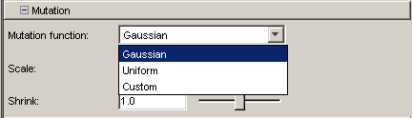
MUTATION
“Principles of Soft Computing, 2nd Edition”
by S.N. Sivanandam & SN Deepa
Copyright © 2011 Wiley India Pvt. Ltd. All rights reserved.

Slide 20
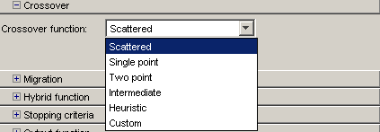
CROSSOVER
“Principles of Soft Computing, 2nd Edition”
by S.N. Sivanandam & SN Deepa
Copyright © 2011 Wiley India Pvt. Ltd. All rights reserved.

Slide 21
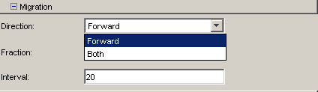
MIGRATION
“Principles of Soft Computing, 2nd Edition”
by S.N. Sivanandam & SN Deepa
Copyright © 2011 Wiley India Pvt. Ltd. All rights reserved.

Slide 22
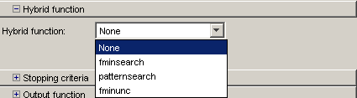
HYBRID FUCNTION
“Principles of Soft Computing, 2nd Edition”
by S.N. Sivanandam & SN Deepa
Copyright © 2011 Wiley India Pvt. Ltd. All rights reserved.

Slide 23
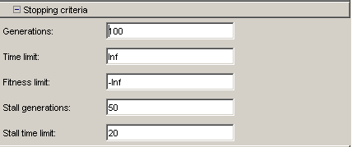
STOPPING CONDITION
“Principles of Soft Computing, 2nd Edition”
by S.N. Sivanandam & SN Deepa
Copyright © 2011 Wiley India Pvt. Ltd. All rights reserved.

Slide 24
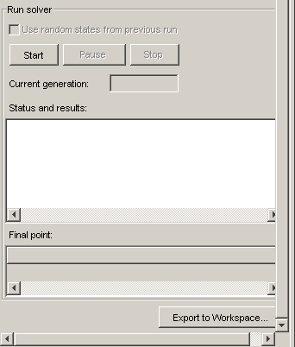
RUNNING AND SIMULATION
“Principles of Soft Computing, 2nd Edition”
by S.N. Sivanandam & SN Deepa
Copyright © 2011 Wiley India Pvt. Ltd. All rights reserved.

Slide 25
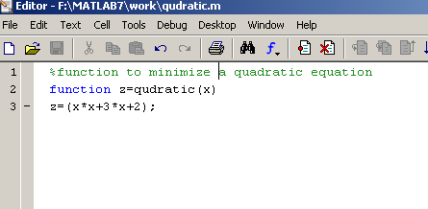
EXAMPLE 1 – FUCNTION WITH SINGLE VARIABLE
Define the given function f(x) = x2+3x+2 in a separate m-file
“Principles of Soft Computing, 2nd Edition”
by S.N. Sivanandam & SN Deepa
Copyright © 2011 Wiley India Pvt. Ltd. All rights reserved.

Slide 26
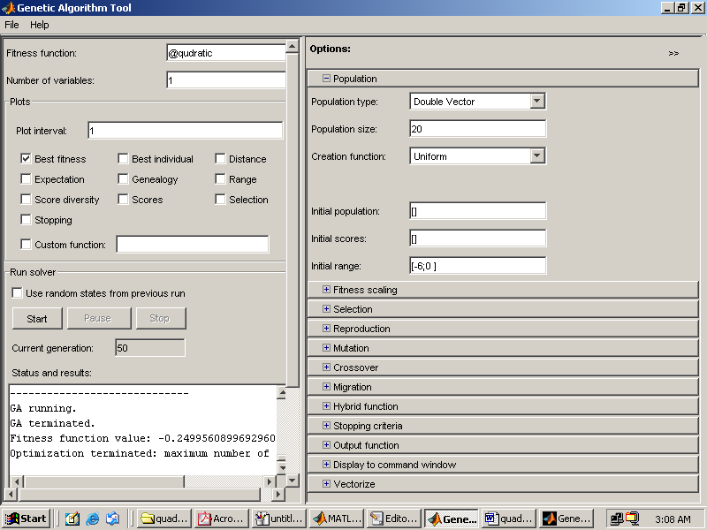
“Principles of Soft Computing, 2nd Edition”
by S.N. Sivanandam & SN Deepa
Copyright © 2011 Wiley India Pvt. Ltd. All rights reserved.

Slide 27
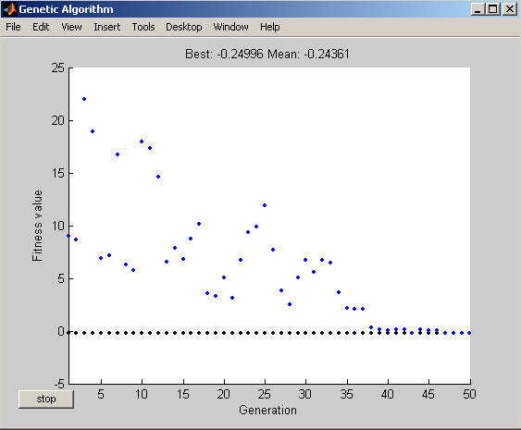
OUTPUT
The output showing the best fitness for 50 generations.
“Principles of Soft Computing, 2nd Edition”
by S.N. Sivanandam & SN Deepa
Copyright © 2011 Wiley India Pvt. Ltd. All rights reserved.

Slide 28
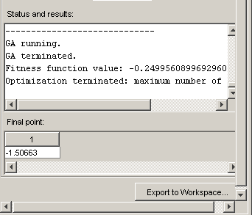
The status and results for this functions for 50 generations
“Principles of Soft Computing, 2nd Edition”
by S.N. Sivanandam & SN Deepa
Copyright © 2011 Wiley India Pvt. Ltd. All rights reserved.

Slide 29
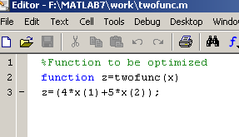
EXAMPLE 2 – FUNCTION WITH TWO VARIABLES
Define the given function f(x1,x2)=4x1+5x2 in a separate m-file.
“Principles of Soft Computing, 2nd Edition”
by S.N. Sivanandam & SN Deepa
Copyright © 2011 Wiley India Pvt. Ltd. All rights reserved.

Slide 30
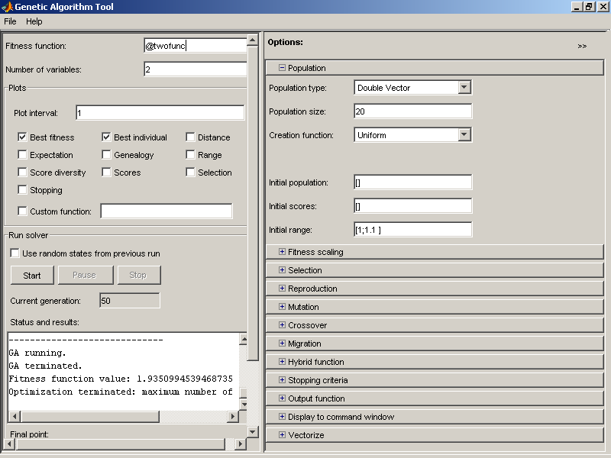
“Principles of Soft Computing, 2nd Edition”
by S.N. Sivanandam & SN Deepa
Copyright © 2011 Wiley India Pvt. Ltd. All rights reserved.

Slide 31
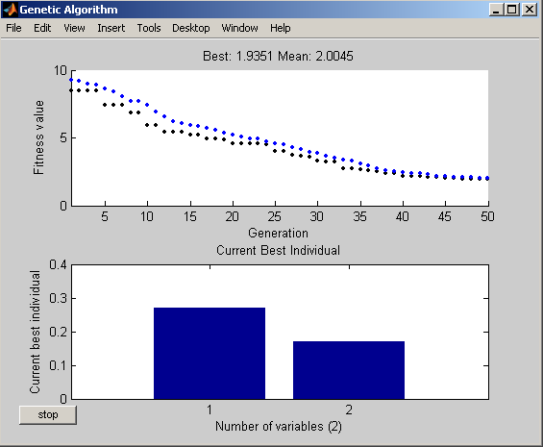
OUTPUT
The output for 50 generations.
“Principles of Soft Computing, 2nd Edition”
by S.N. Sivanandam & SN Deepa
Copyright © 2011 Wiley India Pvt. Ltd. All rights reserved.

Slide 32
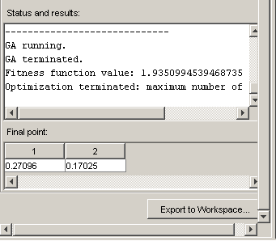
The status and result for this function.
“Principles of Soft Computing, 2nd Edition”
by S.N. Sivanandam & SN Deepa
Copyright © 2011 Wiley India Pvt. Ltd. All rights reserved.

Slide 33
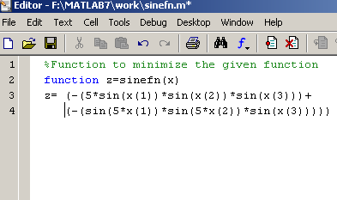
EXAMPLE 3 – SINE FUNCTION
f (x1, x2, x3) = -5sin(x1)sin(x2)sin(x3)+-sin(5x1)sin(5x2)sin(x3)
where 0 <= xi <= pi, for 1<= i <= 3.
“Principles of Soft Computing, 2nd Edition”
by S.N. Sivanandam & SN Deepa
Copyright © 2011 Wiley India Pvt. Ltd. All rights reserved.

Slide 34
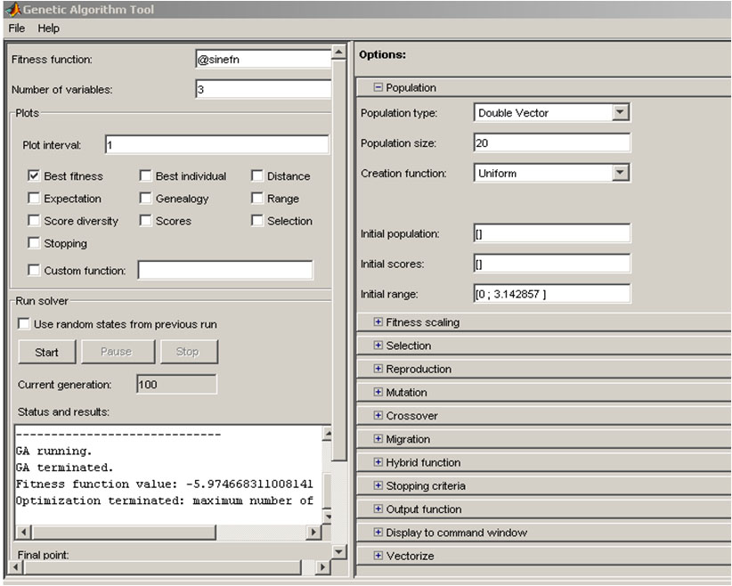
“Principles of Soft Computing, 2nd Edition”
by S.N. Sivanandam & SN Deepa
Copyright © 2011 Wiley India Pvt. Ltd. All rights reserved.

Slide 35
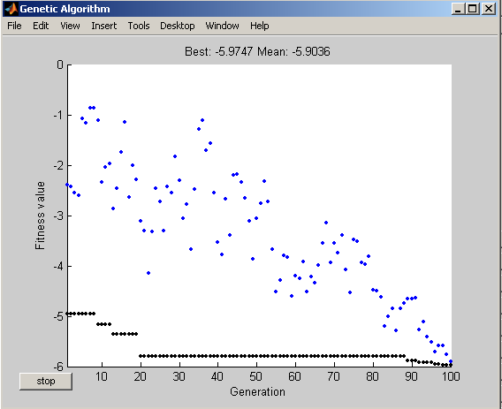
OUTPUT
The output for 100 generations.
“Principles of Soft Computing, 2nd Edition”
by S.N. Sivanandam & SN Deepa
Copyright © 2011 Wiley India Pvt. Ltd. All rights reserved.

Slide 36
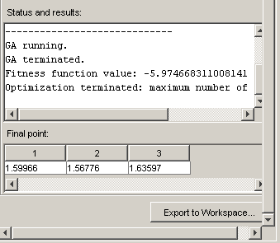
The status and result for this function
“Principles of Soft Computing, 2nd Edition”
by S.N. Sivanandam & SN Deepa
Copyright © 2011 Wiley India Pvt. Ltd. All rights reserved.

